Slide 1

MASSACHUSETTS
Building Decarbonization
Raab Roundtable
June 21, 2019
Massachusetts Dept. of Energy Resources
Judith Judson, Commission

Slide 2
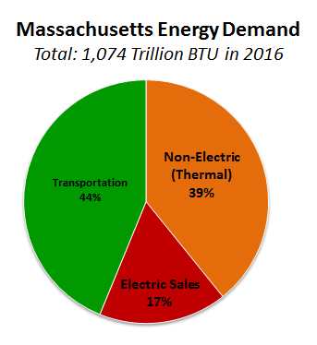
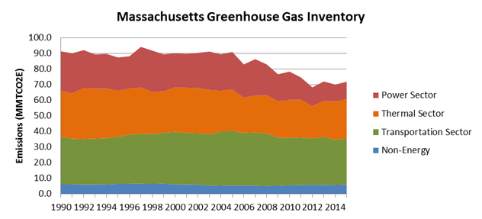
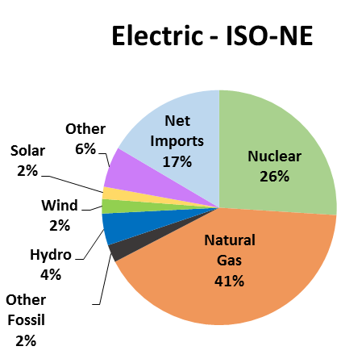
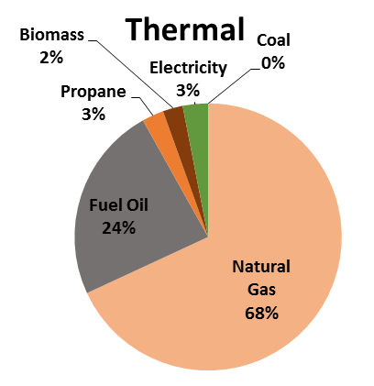
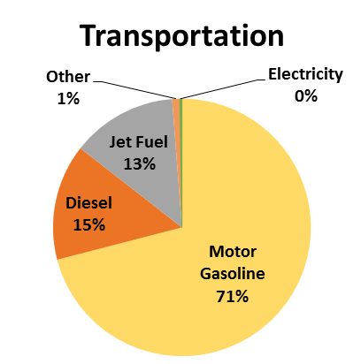
Massachusetts Energy Use and Emissions by Sector
Electric generation is our smallest use of energy in the Commonwealth, but it is where we have made the greatest progress in reducing emissions

Slide 3
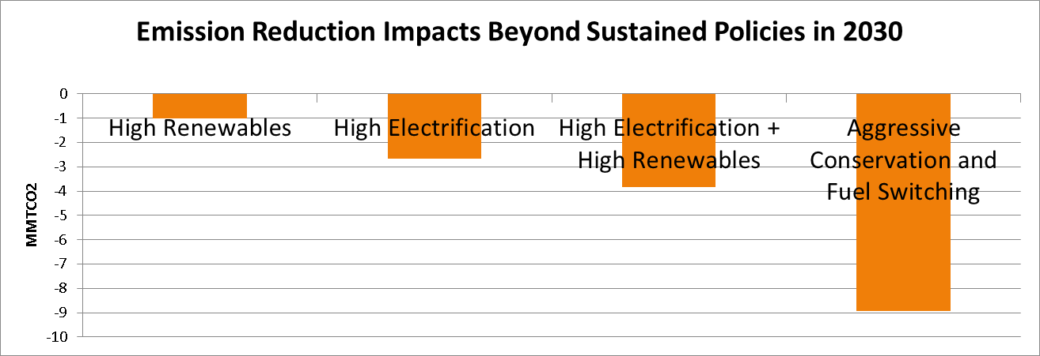
Comprehensive Energy Plan Findings: Impact on Emissions
With sustained policies, Massachusetts estimated to achieve 35% emission reduction from 1990 levels by 2030 (~61 MMTCO₂); key findings for additional reductions:
  Focusing policies primarily on the electric sector has diminishing returns, increasing rates with while realizing only modest decreases in GHG emissions
  Electrifying the thermal and transportation sector leverages investments made in a cleaner electric grid
  Conservation and peak demand reduction important as use of electricity for heating and transportation grows
Greatest amount of emissions reductions are achieved by combining increased use of clean energy in all sectors while simultaneously decreasing overall energy consumption

Slide 4
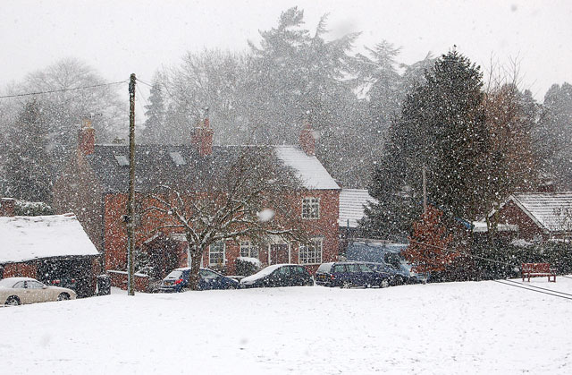


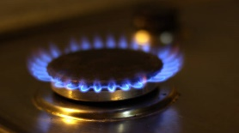

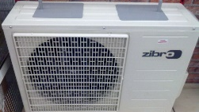
OIL
PROPANE
GAS
ELECTRIC
RESISTANCE
ELECTRIC
COLD CLIMATE
AIR SOURCE
HEAT PUMP
Pounds of emissions to deliver 1 MMBtu of heat into a space
2020
170
145
120
205
65
2030
54% Less
170
145
120
175
55
2050
83% Less
170
145
120
60
20

Slide 5
OIL
PROPANE
GAS
ELECTRIC
RESISTANCE
ELECTRIC
COLD CLIMATE
AIR SOURCE
HEAT PUMP
Pounds of emissions to deliver 1 MMBtu of heat into a space
2020
170
145
120
205
65
2030
54% Less
170
145
120
175
55
2050
83% Less
170
145
120
60
20
39% More
Cost per month in 2030
(2018 dollars, CEP Aggressive Scenario)
$180
$205
$67
$257
$93

Slide 6
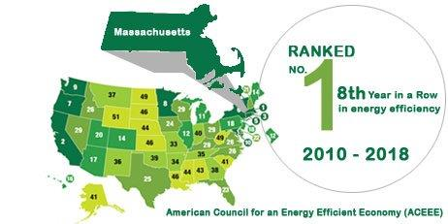
Massachusetts Energy Efficiency Programs
Green Communities Act (2008) requires all cost-effective energy efficiency and demand reduction
An Act to Advance Clean Energy (2018):
  Expands allowable energy efficiency investments to include active demand management (including energy storage), strategic electrification, and fuel switching to clean energy sources.
  Broadens electric efficiency plans to “energy” efficiency plans.
  Changes DPU Cost-effectiveness review to sector-level.

Slide 7
2019-2021 EE Plan Overview
  $2.7 billion investment → $9.3 billion in benefits
  Highest gas savings goals to date
  Electric savings goals reflect expansion in programs:
MMBtu Reduction (electric, oil, propane, etc.)
MWH Savings (excluding fuel switching)
Peak Demand Reduction (Summer, Winter), including active demand
MWH Reduction
MW Demand Reduction

Slide 8


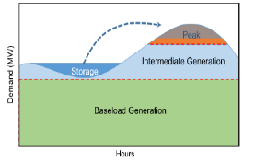

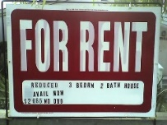
3 Year Energy Efficiency Plan: 2019 – 2021
Summary of New Initiatives
Fuel Switching: customers will be provided information on cleaner fuel options for heating with new incentives for customers to fuel switch to air source heat pumps and other renewable heating options.
Active Demand Reduction: Programs that help offset the most expensive hours of the year through load reduction and active dispatch including energy storage.
Passive House – training and rebates achieve greater energy efficiency in new construction
Home Energy Scorecards: through in-home energy audits, providing information to customers on the benefits of energy efficiency upgrades
Improved Outreach: Enhanced strategies and community outreach efforts targeting increased participation and savings for renters, moderate income customers and non‑English speaking customers, and small businesses

Slide 9
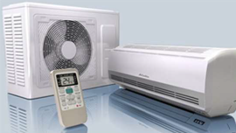
Fuel Switching and
Strategic Electrification
Consumer education through fuel-neutral heating and hot water recommendations during in-home assessments
New incentives for customers to fuel switch to air source heat pumps and other renewable heating options.
Offsetting higher emitting fuels like oil and propane.
Heat Pump Goals
38,000 Residential Customers
6,000 Low Income Customers
18,000 C&I Units

Slide 10
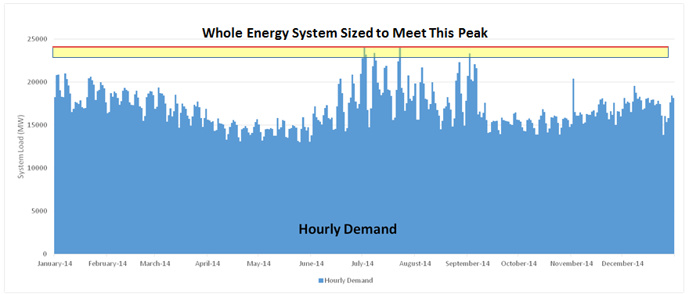
Active Demand Reduction
New Statewide Active Demand Reduction Programs include residential direct load control, energy storage, C&I load curtailment
New shareholder performance incentive for utilities for active demand benefits
Statewide Goal | 2019-2021
Summer MW Total | 693
Winter MW Total | 544
Active Summer MW | 200
Active Winter MW | 50
25,000
In 2015 :
The top 1% of Hours accounted for 8% of MA Spend on Electricity
Top 10% of Hours accounted for 40% of Electricity Spend
20,000
15,000
New England Electricity Demand (MW)
10,000
5,000
0
January
February
March
April
May
June
July
August
September
October
November
December

Slide 11
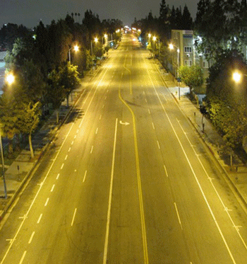
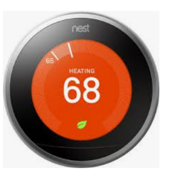
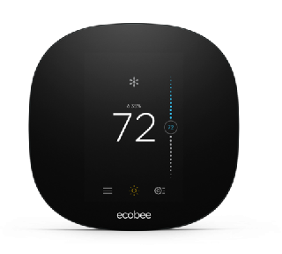
Winter Reliability
Focus on natural gas savings (therm savings goals increased over 12% from previous plan)
Continued focus on insulation/weatherization
Utilizing active demand technologies in winter, including storage
LED streetlight conversions

Slide 12
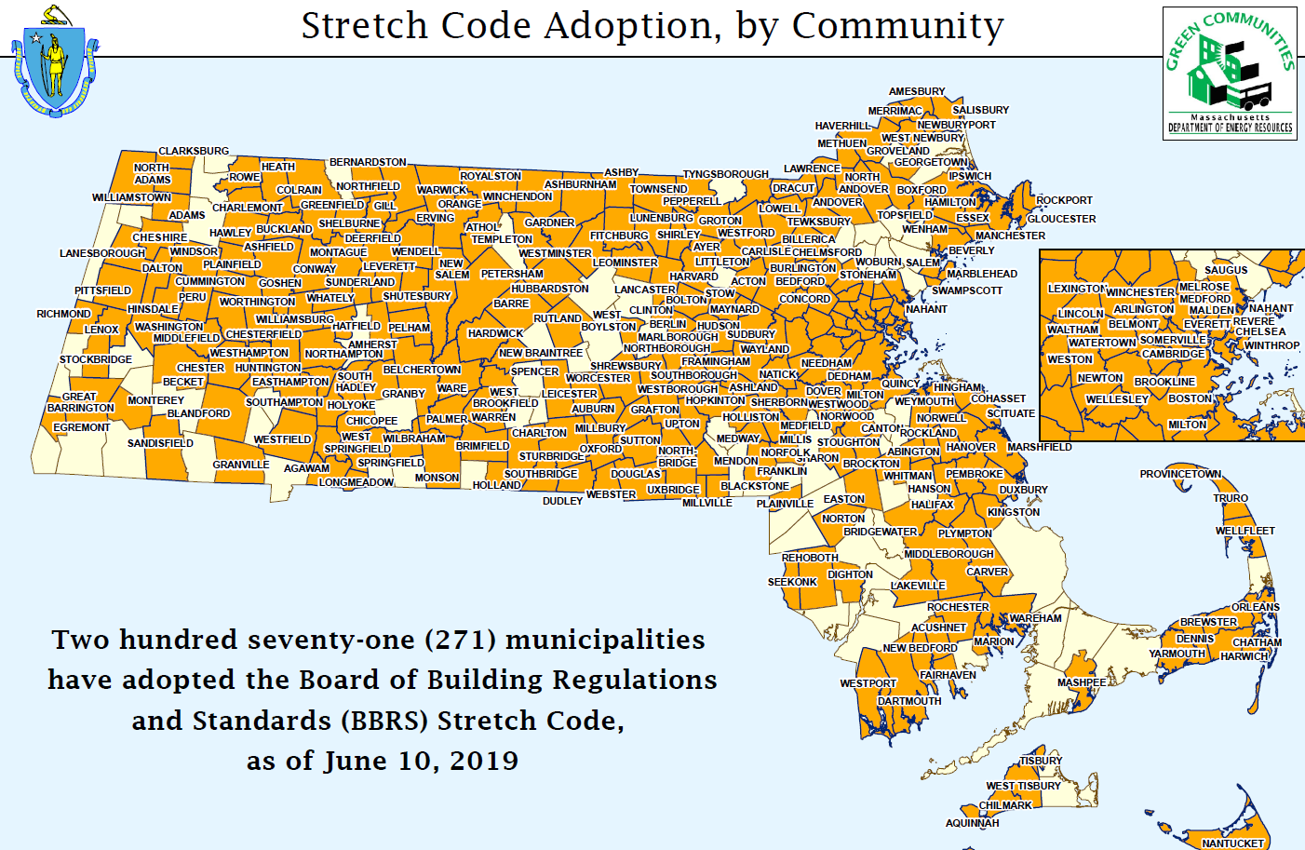
Advanced Building Codes
MA adopted IECC 2018 Base Building Code w/ Amendments
On June 11th, BBRS directed the Energy Advisory Committee (chaired by DOER) to develop net-zero stretch code framework

Slide 13
What’s Next?
80 X 50 Study to Inform Development of 2030 Clean Energy and Climate Plan
All Cost-Effective Energy Efficiency: Continue, Expand, Identify new areas
Building as Grid Assets
Advanced Building Energy Codes
Appliance and Product Standards
Expand Renewable Thermal Market: Alternative Portfolio Standard 2020 Review
Continue electric sector progress, including off-shore wind procurements and Clean Peak Standard
R&D for renewable gas
Building Energy Rating and Labeling

Slide 14

THANK YOU

